Slide 1

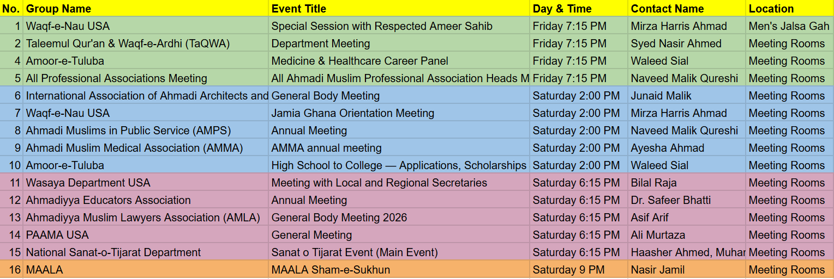
Special Events - Jalsa USA 2026
NOTES:
Basic AV setup will be provided (e.g. microphone, speakers, TV). For anything additional, please make your own arrangements
Any food service must be coordinated with langar and must be removed and cleaned-up afterwards
Meeting room location assignment will be displayed during your time slot in the Special Events Meeting area
This Schedule:
https://tinyurl.com/jalsaeventsinfo26
Form:
https://tinyurl.com/jalsaeventsform26
Updated: 6/29/26

Slide 2
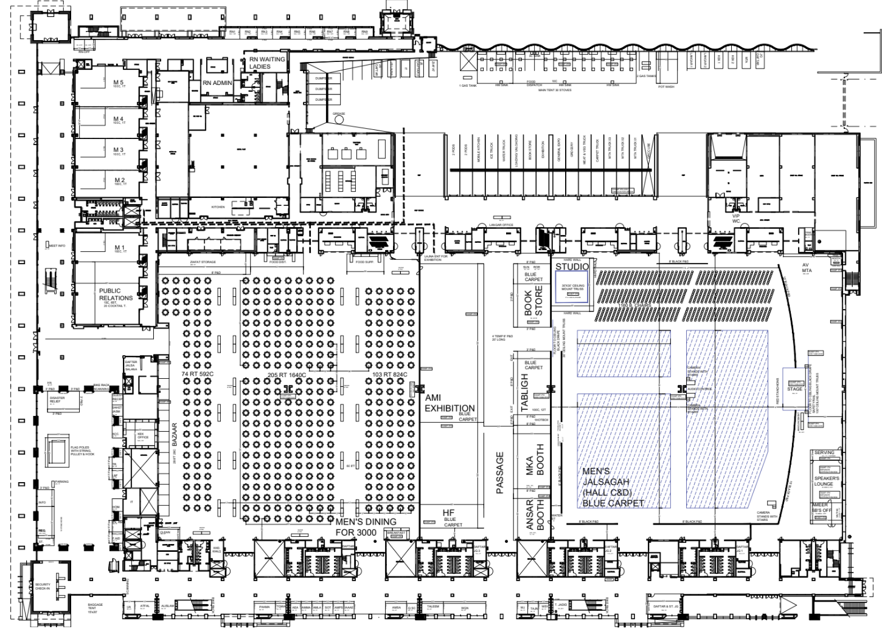
Map of Rooms
Special
Events
Meeting
Rooms

Slide 3
Team
Nazim: Fouzan Pal
Naib Nazim: Naeemuddin Tahir Mehmood
Muavins: Ameeruddin Malik, Shayan Choudhary, Muneeb Pal, Danisch Malik, Ali Iqbal

Slide 4







Room Configuration
M5
M4
1/3
Ladies
Wireless mic
M3
Partition
Misc.
Table
Podium
w/ Mic
HDMI
Cable
M2
Entrance
2/3
Men
Wireless mic
Head Table
w/ Mic
Bathrooms
Laptop & USB drive
M1

Slide 5
Special Events - Jalsa USA 2026
FRIDAY EVENING

Slide 6
Special Events - Jalsa USA 2026
SATURDAY AFTERNOON

Slide 7
Special Events - Jalsa USA 2026
SATURDAY EVENING

